Slide 1
Discrete Mathematics and Its Application 7th edition, 2001
Kenneth H. Rosen

Slide 2
Welcome to Discrete Mathematics Spring 2018
Instructor: Niu Shao Zhang

Slide 3
§2.2 Set Operations
Propositional calculus （命题演算）and set theory（集合论） are both instances of an algebraic system （代数系统）called a
Boolean Algebra（布尔代数）
The operators in set theory are defined in terms of the corresponding operator in propositional calculus
As always there must be a universe U. All sets are assumed to be subsets of U

Slide 4
Equal（相等）
Definition: Two sets A and B are equal, denoted A = B, iff
∀x ( x ∈A ↔ x ∈B ) .
Note: By a previous logical equivalence we have
A = B iff ∀x[(x ∈A→ x ∈B) ∧ (x ∈B→ x ∈A)]
or
A = B iff A ⊆ B and B⊆ A

Slide 5
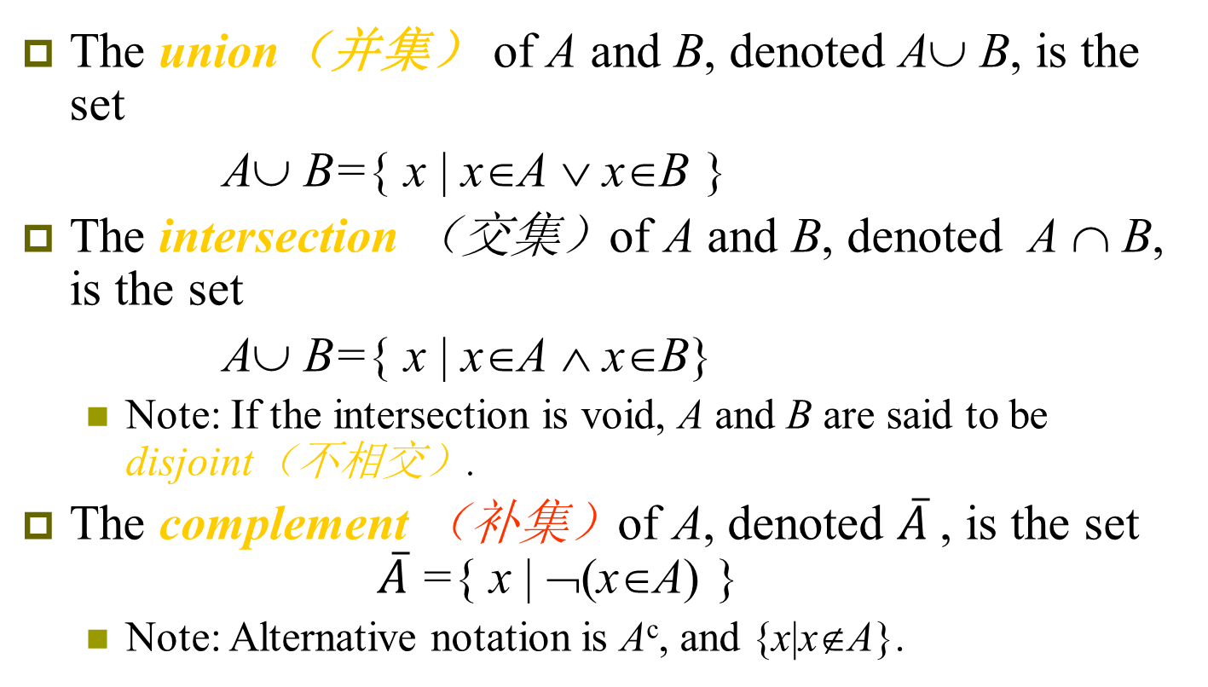
Definitions
The union（并集） of A and B, denoted A∪ B, is the set
A∪ B={ x | x∈A ∨ x∈B }
The intersection （交集）of A and B, denoted A ∩ B, is the set
A∪ B={ x | x∈A ∧ x∈B}
Note: If the intersection is void, A and B are said to be disjoint（不相交）.
The complement （补集）of A, denoted $\overline{A}$, is the set $\overline{A}$={ x | ¬(x∈A) }
Note: Alternative notation is A^{c}, and {x|x∉A}.

Slide 6
The Inclusion-Exclusion Principle （容斥原理）
Theorem
If A and B are finite sets, then
|A∪B|=|A|+|B|-|A∩B|
It also called the inclusion-exclusion principle（容斥原理）
U
A A∩B B

Slide 7
Example
Let A={a, b, c, d, e} and B={c, e, f, h, k, m}. Verify inclusion-exclusion principle.
Solution:
A∪ B={a, b, c, d, e, f, h, k, m} and A∩ B={ c, e}
|A|= 5, |B|= 6, | A∪ B |= 9 and | A∩ B |= 2
|A|+|B|-| A∩ B |= 9=| A∪ B |
Q.E.D

Slide 8
The Inclusion-Exclusion Principle for Disjoint Sets
|A∪B|=|A|+|B|

Slide 9
Difference（差）
Definition: Let A and B be sets. The difference of A and B, denoted by A – B, is the set containing the elements of A that are not in B. The difference of A and B is also called the complement of B with respect to A.
A – B = {x | x ∈ A ∧ x ∉ B} = A ∩‾B
U
Venn Diagram for A − B
A
B

Slide 10

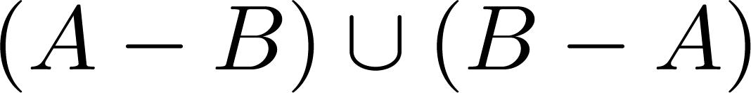
Symmetric Difference (对称差)
Definition: The symmetric difference of A and B, denoted by is the set
Example:
U = {0,1,2,3,4,5,6,7,8,9,10}
A = {1,2,3,4,5} B ={4,5,6,7,8}
What is:
Solution: {1,2,3,6,7,8}
U
A
B
Venn Diagram

Slide 11



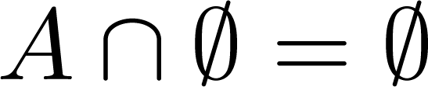


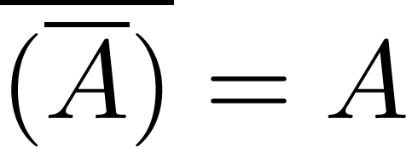
Set Identities
Identity laws
Domination laws
Idempotent laws
Complementation law
Continued on next slide →

Slide 12


Set Identities
Commutative laws
Associative laws
Distributive laws
Continued on next slide →

Slide 13


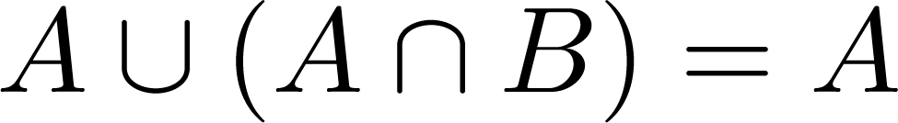
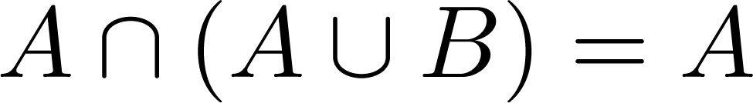

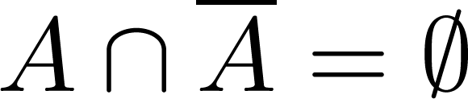
Set Identities
De Morgan’s laws
Absorption laws
Complement laws

Slide 14
Proving Set Identities
Different ways to prove set identities:
Prove that each set (side of the identity) is a subset of the other. ( E₁ ⊆ E₂ and E₂ ⊆ E₁ ) （证互相包含）
Use set builder notation and propositional logic.
Membership Tables(集合成员表): Verify that elements in the same combination of sets always either belong or do not belong to the same side of the identity. Use 1 to indicate it is in the set and a 0 to indicate that it is not.

Slide 15
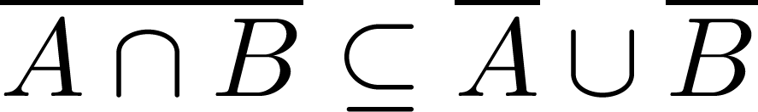
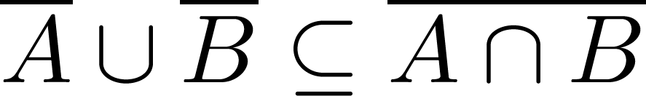
Method 1: Mutual subsets
Proof of Second De Morgan Law
Example: Prove that
Solution: We prove this identity by showing that:
1) and
2)
Continued on next slide →

Slide 16
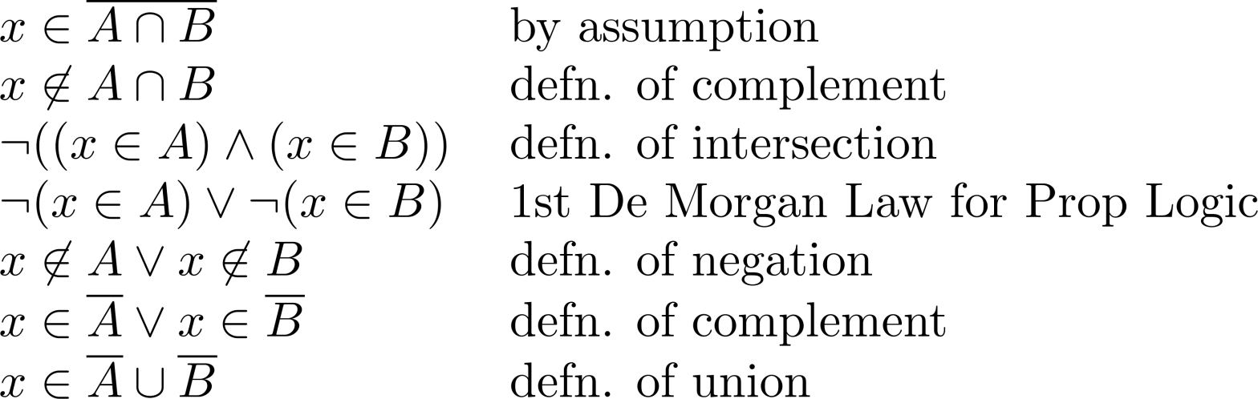
Method 1: Mutual subsets
These steps show that:
Continued on next slide →

Slide 17
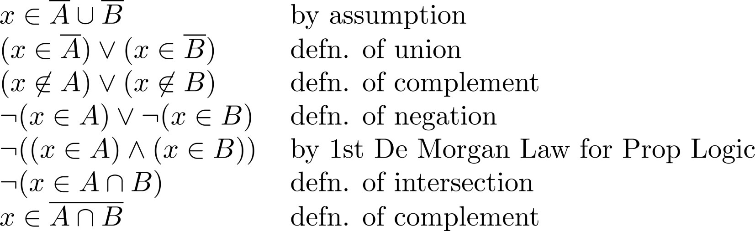
Method 1: Mutual subsets
These steps show that:

Slide 18
Method 2: Use set builder notation
EXAMPLE 10 Proof that

Slide 19
Method 3: Membership Tables
Just like truth tables for propositional logic.
Columns for different set expressions.
Rows for all combinations of memberships in constituent sets.
Use “1” to indicate membership in the derived set, “0” for non-membership.
Prove equivalence with identical columns.

Slide 20
Membership Table Example
Prove (A∪B)−B = A−B.

Slide 21





Membership Table
Example:
Construct a membership table to show that the distributive law holds.
Solution:
A | B | C
1 | 1 | 1 | 1 | 1 | 1 | 1 | 1
1 | 1 | 0 | 0 | 1 | 1 | 1 | 1
1 | 0 | 1 | 0 | 1 | 1 | 1 | 1
1 | 0 | 0 | 0 | 1 | 1 | 1 | 1
0 | 1 | 1 | 1 | 1 | 1 | 1 | 1
0 | 1 | 0 | 0 | 0 | 1 | 0 | 0
0 | 0 | 1 | 0 | 0 | 0 | 1 | 0
0 | 0 | 0 | 0 | 0 | 0 | 0 | 0

Slide 22
Generalized Unions & Intersections
Since union & intersection are commutative and associative, we can extend them from operating on ordered pairs of sets (A,B) to operating on sequences of sets (A₁,…,A_{n}), or even on unordered sets of sets, X={A | P(A)}.

Slide 23
Generalized Union
Binary union operator: A∪B
n-ary union: A∪A₂∪…∪A_{n} :≡ ((…((A₁∪ A₂) ∪…)∪ A_{n}) (grouping & order is irrelevant)
“Big U” notation:
Or for infinite sets of sets:

Slide 24
Generalized Intersection
Binary intersection operator: A∩B
n-ary intersection: A₁∩A₂∩…∩A_{n}≡((…((A₁∩A₂)∩…)∩A_{n}) (grouping & order is irrelevant)
“Big Arch” notation:
Or for infinite sets of sets:

Slide 25
Notation
A∪B∪C= {x | x∈A∨x∈B∨x∈C}
A₁∪A₂∪…A_{n=}
A∩B∩C= {x | x∈A∧x∈B∧x∈C}
A₁∩A₂∩…A_{n=}

Slide 26


Union and Intersection of Indexed Collections
Let A₁,A₂ ,..., A_{n} be an indexed collection of sets.
Union and intersection are associative (because 'and' and 'or' are) we have:
A_{i} = A₁∪ A₂∪...∪A_{n}
and
A_{i} = A₁ ∩ A₂ ∩...∩ A_{n}

Slide 27
Examples
Let
A_{i} = [i,∞),1 ≤ i < ∞
then
A_{i} = [1,∞)
A_{i} = [n,∞)

Slide 28
Representations
A frequent theme of this course will be methods of representing one discrete structure using another discrete structure of a different type.
E.g., one can represent natural numbers as
Sets: 0:≡∅, 1:≡{0}, 2:≡{0,1}, 3:≡{0,1,2}, …
Bit strings: 0:≡0, 1:≡1, 2:≡10, 3:≡11, 4:≡100, …

Slide 29
Representing Sets with Bit Strings
For an enumerable u.d. U with ordering x₁, x₂, …, represent a finite set S⊆U as the finite bit string B=b₁b₂…b_{n} where ∀i: x_{i}∈S ↔ (i<n ∧ b_{i}=1).
E.g. U=N, S={2,3,5,7,11}, B=001101010001.
（自然数从零开始）
In this representation, the set operators “∪”, “∩”, “‾” are implemented directly by bitwise OR, AND, NOT!
Notes:
So, for example, on a 64-bit processor, using just a single machine-language instruction you can calculate the union or intersection of two sets out of a universe of discourse having up to 64 elements. This leads to an extremely fast way of doing complicated calculations on small sets. It is not a good method for large, sparsely populated sets, because searching the bit string to find which bits are “1” can take a long time.

Slide 30
Computer representation of sets
Example 18
Let U = {1, 2, 3, 4, 5, 6, 7, 8, 9, 10}, and the ordering of elements of U has the elements in increasing order; that is, a_{i} = i. What bit strings represent the subset of all odd integers in U, the subset of all even integers in U, and the subset of integers not exceeding 5 in U?
Solution：U = {1, 2, 3, 4, 5, 6, 7, 8, 9, 10},（全集 从1开始）it is 1 1 1 1 1 1 1 1 1 1
The subset of all odd integers is {1, 3, 5, 7, 9}, it is
1 0 1 0 1 0 1 0 1 0
The bit strings represent The subset of all even integers is
0 1 0 1 0 1 0 1 0 1
The subset of integers not exceeding 5 is 1 1 1 1 1 0 0 0 0 0

Slide 31
Computer representation of sets
Example 19
We have seen that the bit string for the set {1, 3, 5, 7, 9} (with universal set {1, 2, 3, 4,5, 6, 7, 8, 9, 10}) is 10 1010 1010.What is the bit string for the complement of this set?
Solution：U = {1, 2, 3, 4, 5, 6, 7, 8, 9, 10}, it is
1 1 1 1 1 1 1 1 1 1
The subset of all odd integers is {1, 3, 5, 7, 9}, it is
1 0 1 0 1 0 1 0 1 0
The bit string for the complement of this set is
0 1 0 1 0 1 0 1 0 1 (逐位取反)

Slide 32
Computer representation of sets
Example 20
The bit strings for the sets {1, 2, 3, 4, 5} and {1, 3, 5, 7, 9} are 11 1110 0000 and 10 1010 1010,respectively. Use bit strings to find the union and intersection of these sets.
Solution： 1 1 1 1 1 0 0 0 0 0
1 0 1 0 1 0 1 0 1 0
The union is 1 1 1 1 1 0 1 0 1 0，the corresponds set is {1, 2, 3, 4, 5, 7, 9}. (逐位析取)
The intersection is
1 0 1 0 1 0 0 0 0 0 (逐位合取)
the corresponds set is {1, 3, 5}.

Slide 33
homework
4,19,30,48,52,56

